Slide 1

Cascading style sheet(CSS)
Skills Build For Adults

Slide 2
Agenda
Introduction to CSS
Separation of Content and Presentation
CSS Fundamentals
CSS Animations
CSS transitions
Media Queries
CSS Responsive Frameworks
CSS Best Practices and Performance Optimization
CSS3 Features
QA

Slide 3
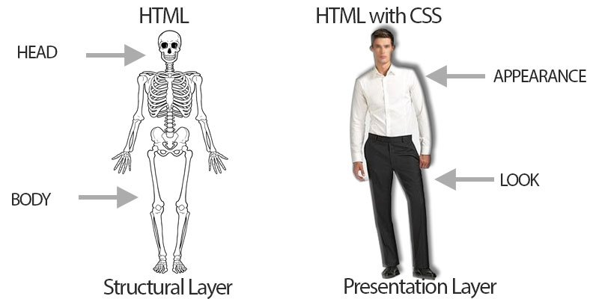
Introduction to CSS
CSS stands for Cascading Style Sheets.
It is a language used for describing the presentation and formatting of a document written in HTML.
CSS separates the content and presentation aspects of web development.
It allows developers to control the layout, colors, fonts, and other visual aspects of a website.
By separating the content from the presentation, CSS provides more flexibility, consistency, and ease of maintenance in web development.
Image Source : https://tutorial.techaltum.com/images/css-3.jpg

Slide 4
Separation of Content and Presentation
CSS enables the separation of content and presentation in web development.
Content refers to the text, images, and structure of a web page.
Presentation includes the styling, layout, and visual aspects of the page.
By using CSS, developers can define the presentation rules in a separate CSS file or within the HTML file itself.
This separation allows for easier updates and changes to the presentation without affecting the content.
It also enables the reuse of styles across multiple web pages, improving consistency and reducing redundancy.

Slide 5
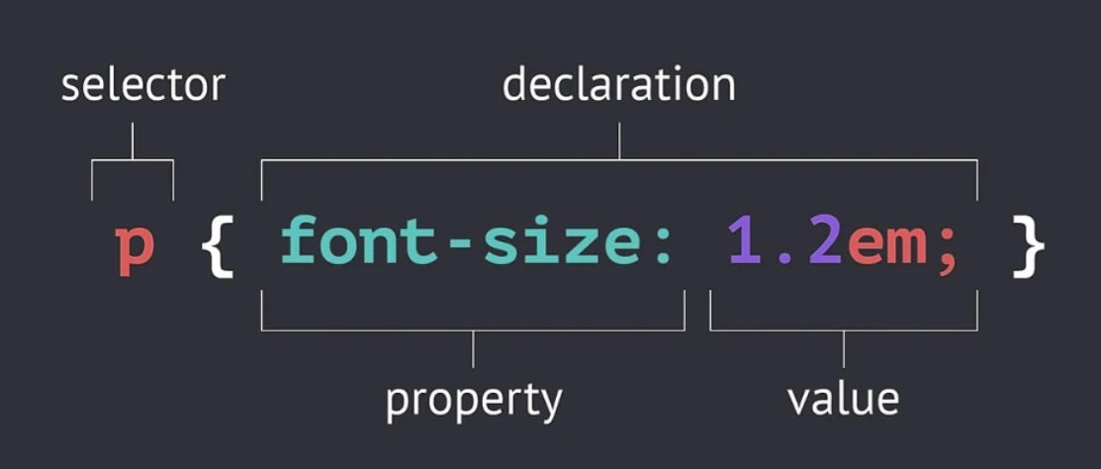
Basic Syntax of CSS Rules, Selectors, and Properties
CSS rules consist of a selector and a declaration block.
Selectors target HTML elements, while the declaration block contains one or more property-value pairs.

Slide 6
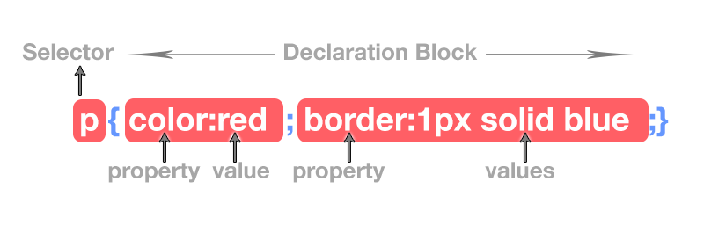
Example of a Simple CSS Rule
Selector: In this example, we'll use the selector "h1" to target all the heading level 1 elements in HTML.
Declaration Block: Within the declaration block, we'll set the "color" property to "red" to change the text color of the selected elements.
Image Source : https://tutorial.techaltum.com/images/css-3.jpg

Slide 7
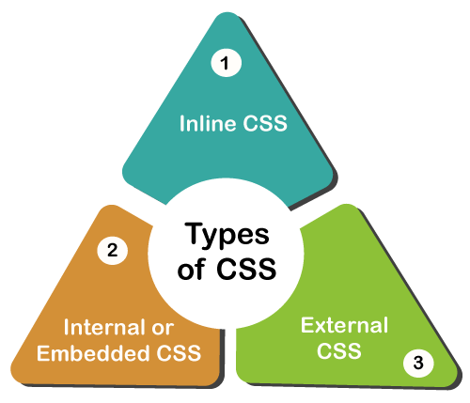
Inline CSS
Inline CSS allows you to apply styles directly to individual HTML elements using the "style" attribute.
The "style" attribute is added within the opening tag of an HTML element.
Inline styles override external and internal CSS styles.
Image URL : https://www.javatpoint.com/types-of-css
Notes:
Note: Inline CSS is useful for quickly applying specific styles to individual elements, but it can be less maintainable and reusable compared to external or internal CSS stylesheets.

Slide 8
Internal CSS
Internal CSS allows you to include CSS styles directly within the HTML file, using the <style> tag.
This method is useful when you want to apply styles to specific elements on a single page.
To use internal CSS, place the <style> tag within the <head> section of your HTML file.
Within the <style> tag, write your CSS rules and properties as you would in an external CSS file.
Image URL : https://www.javatpoint.com/types-of-css

Slide 9
External CSS
Use the "link" tag with the "rel" attribute set to "stylesheet" to link an external CSS file.
Specify the "href" attribute to indicate the path to the external CSS file.
Benefits of External CSS:
Allows for better organization and separation of concerns, as styles are stored in a separate file.
Multiple HTML files can share the same stylesheet, reducing redundancy and making global style changes easier.
Image URL : https://www.javatpoint.com/types-of-css

Slide 10
CSS Selectors
Element Selectors:
CSS element selectors target specific HTML elements on a page.
Example: To target all paragraphs on a page, you can use the "p" selector in CSS: p { color: blue; }
Class Selectors:
CSS class selectors target HTML elements with a specific class attribute.
Example: To target all elements with the class "highlight", you can use the ".highlight" selector in CSS: .highlight { background-color: yellow; }
Image Source : https://tutorial.techaltum.com/images/css-3.jpg

Slide 11
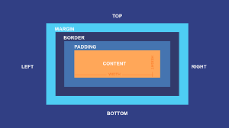
CSS Box Model
The CSS Box Model is a fundamental concept in CSS that describes how elements are rendered on a web page. It consists of four components:
Content: The actual content of the element, such as text or images.
Padding: The space between the content and the element's border. It can be set using the padding property.
Border: A line that surrounds the element's content and padding. It can be customized using the border property.
Margin: The space between the element's border and neighboring elements. It can be set using the margin property.
Image URL : https://edu.gcfglobal.org/en/basic-css/the-css-box-model/1/

Slide 12
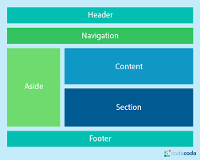
CSS Layouts
CSS provides several techniques for creating different layouts on web pages. Let's explore two popular CSS layout techniques: Float and Flexbox.
Image URL :https://codecoda.com/en/blog/entry/css-layout-grid-vs-flexbox

Slide 13
CSS Layouts - Float Layout
The float property allows elements to be positioned horizontally, either to the left or right of their container.
Floating elements can affect the flow of surrounding elements, making them wrap around the floated element.
Common use cases include creating multi-column layouts or positioning elements within a larger container.

Slide 14
CSS Layouts - Flexbox Layout
Flexbox is a modern CSS layout model designed to create flexible and responsive layouts.
It allows elements to be automatically arranged within a container, either in a single row or a single column.
Flexbox provides powerful alignment, distribution, and ordering capabilities.

Slide 15
CSS Layouts - CSS Grid
CSS Grid is a powerful layout system that allows for two-dimensional grid-based layouts. It provides a more advanced and fine-grained control over element placement compared to float or flexbox layouts.
Key Features of CSS Grid:
Grid Container: The parent element that contains the grid items.
Grid Items: The children of the grid container that are placed within the grid.
Grid Tracks: The rows and columns that make up the grid.
Grid Lines: The horizontal and vertical lines that divide the grid tracks.
Grid Areas: Rectangular areas within the grid that contain grid items.

Slide 16
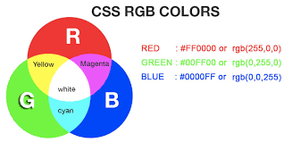
CSS Colors
Color
Background Color

Slide 17
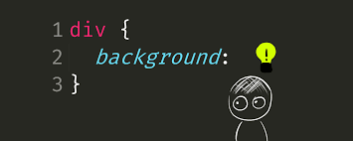
CSS Backgrounds
Background Image
Background Repeat
Background Position.
Gradient Backgrounds
Image Source : https://levelup.gitconnected.com/getting-creative-with-the-css-background-property-2455aedcb408

Slide 18
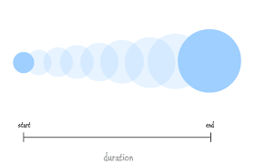
CSS Transitions
Transitions enable smooth property changes over a specified duration.
The transition-property property defines which CSS properties should be transitioned.
The transition-duration property sets the time it takes for the transition to complete.
The transition-timing-function property specifies the speed curve of the transition.
The transition-delay property adds a delay before the transition starts.
Image URL : https://coursework.vschool.io/css-transitions/

Slide 19

CSS Animations
Animations create more complex and customized effects.
Keyframes are used to define the intermediate states during the animation.
The animation-name property specifies the name of the keyframe animation.
The animation-duration property sets the duration of the animation.
The animation-timing-function property defines the timing curve of the animation.
The animation-delay property adds a delay before the animation starts.
The animation-iteration-count property controls how many times the animation repeats.
The animation-direction property sets the direction of the animation.
Image URL : https://stfalcon.com/en/blog/post/animation-css

Slide 20
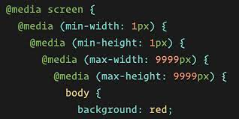
CSS MEDIA QUERIES
CSS media queries enable you to apply different styles based on various device characteristics, such as screen size, resolution, and device type.
Syntax
Media queries start with the @media rule followed by the query conditions enclosed in parentheses.
Query conditions can be based on the screen width, height, orientation, and more.
Image URL: https://css-tricks.com/nested-media-queries/

Slide 21
CSS MEDIA QUERIES(Contd..)
CSS media queries enable you to apply different styles based on various device characteristics, such as screen size, resolution, and device type.
Syntax
Media queries start with the @media rule followed by the query conditions enclosed in parentheses.
Query conditions can be based on the screen width, height, orientation, and more.
Image URL: https://css-tricks.com/nested-media-queries/

Slide 22
CSS MEDIA QUERIES(Contd..)
Applying Different Styles
Inside a media query block, you can write CSS rules specific to the query conditions.
These rules will only be applied when the conditions are met.
Responsive Design
Media queries are commonly used in responsive web design to create adaptive layouts.
By adjusting styles based on screen size, you can optimize the user experience on different devices.

Slide 23
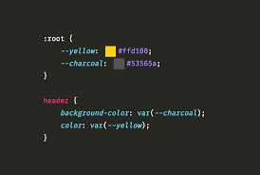
CSS Variables
CSS variables, also known as custom properties, provide a powerful way to store and reuse values in CSS. Let's explore CSS variables and their usage:
Declaration: CSS variables are declared using the -- prefix followed by a name and a value.
Usage: CSS variables can be used in any CSS property value by referencing them with the var() function.
Updating Values
Cascading and Inheritance
Fall Back Values

Slide 24
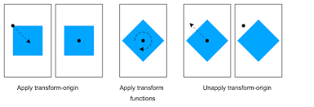
CSS Transformations
CSS transformations allow you to modify the appearance and layout of elements in 2D and 3D space. Let's explore the key concepts of CSS transformations:
Transform Property:
The transform property is used to apply transformations to an element.
It accepts various transformation functions as values.
Image URL : https://www.w3.org/TR/css-transforms-1/

Slide 25
CSS Transformations
2D Transforms
CSS provides several 2D transformation functions, including rotate, scale, translate, skew, and matrix.
Each function alters the element's position, size, or shape in the 2D plane.
3D Transforms
CSS supports 3D transformations, allowing you to manipulate elements in three-dimensional space.
3D transforms include rotateX, rotateY, rotateZ, scale3D, translate3D, and matrix3D
Image URL : https://www.w3.org/TR/css-transforms-1/

Slide 26
CSS Responsive Frameworks
CSS responsive frameworks provide pre-built components and layouts that help in creating responsive web designs. Let's explore the benefits and features of CSS responsive frameworks:
Simplified Responsive Design
Grid Systems
Responsive Components
Cross-Browser Compatibility
Rapid Development
Community Support and Resources

Slide 27
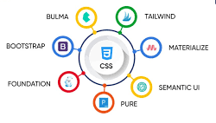
Popular CSS Responsive Frameworks
Bootstrap: A widely used framework that offers a robust set of components, a responsive grid system, and extensive documentation.
Foundation: A responsive framework that provides flexible grid layouts, customizable components, and built-in JavaScript plugins.
Bulma: A lightweight and modular framework that emphasizes simplicity and ease of use.
Tailwind CSS: A utility-first framework that allows you to rapidly build custom designs using pre-defined classes.
Image URL: https://www.tekkiwebsolutions.com/blog/best-css-frameworks-for-web-developers/

Slide 28
CSS Best Practices and Performance Optimization
Implementing CSS best practices and optimizing performance are crucial for efficient and maintainable code.
Let's explore some key best practices and techniques:
Minimize and Concatenate CSS:
Minify and concatenate your CSS files to reduce file size and minimize the number of HTTP requests.
Use tools or build processes to automate this optimization step.
Use External CSS:
Use external CSS files instead of inline or internal styles.
External stylesheets can be cached by the browser, leading to faster subsequent page loads.
Organize and Modularize CSS:
Use a modular approach, such as CSS modules or component-based CSS, to organize your styles.
Divide your styles into smaller, manageable files, improving code maintainability.

Slide 29
CSS Best Practices and Performance Optimization (Contd...)
Limit Selectors:
Use specific selectors to target elements instead of relying on excessive descendant or universal selectors.
Reduce the number of selectors in your stylesheets for improved performance.
Optimize CSS Specificity:
Avoid using overly specific CSS selectors whenever possible.
Use the appropriate level of specificity to target elements without adding unnecessary weight to your stylesheets.
Reduce CSS Redundancy:
Regularly review your CSS to identify and eliminate redundant or unused styles.
Remove any duplicated styles to streamline your code.
Optimize CSS Animations and Transitions:
Use CSS animations and transitions judiciously, as they can impact performance.
Minimize the number of animated properties and elements to optimize performance.

Slide 30
CSS Best Practices and Performance Optimization (Contd...)
Use CSS Sprites or Icon Fonts:
Combine small images into a single image sprite to reduce the number of HTTP requests.
Alternatively, consider using icon fonts for scalable and efficient icon usage.
Limit the Use of @import:
Minimize the use of @import statements, as they block parallel downloads and slow down page rendering.
Instead, use external CSS files or utilize modern import methods like link tags.
Regularly Audit and Refactor CSS:
Conduct regular code reviews and audits to identify areas for improvement and optimization.
Refactor and optimize your CSS codebase to eliminate redundancy, reduce complexity, and improve performance.

Slide 31
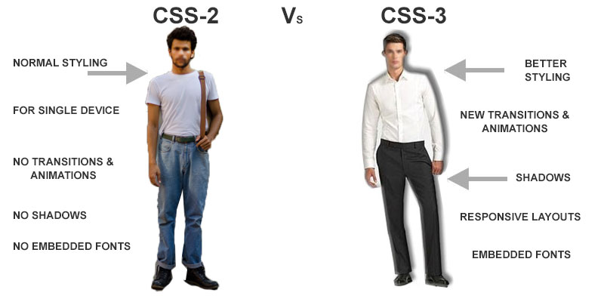
CSS3 Features
CSS3 introduces a wide range of new features that enhance the styling and interactivity of web pages. Let's explore some key CSS3 features
Image Source : https://tutorial.techaltum.com/images/css-3.jpg

Slide 32
CSS3 Features(Contd..)
Rounded Corners
Gradients
Transitions
Animations
Transformations
Shadows and Effects
Flexbox
Grid Layout
Media Queries
Custom Fonts
Image Source : https://tutorial.techaltum.com/images/css-3.jpg

Slide 33


Slide 34
References
MDN Web Docs (developer.mozilla.org)
CSS-Tricks (css-tricks.com)
W3Schools (w3schools.com/css)
Codrops (tympanus.net/codrops/css_reference)
CSS Gradient (cssgradient.io)

Slide 35


